Slide 1
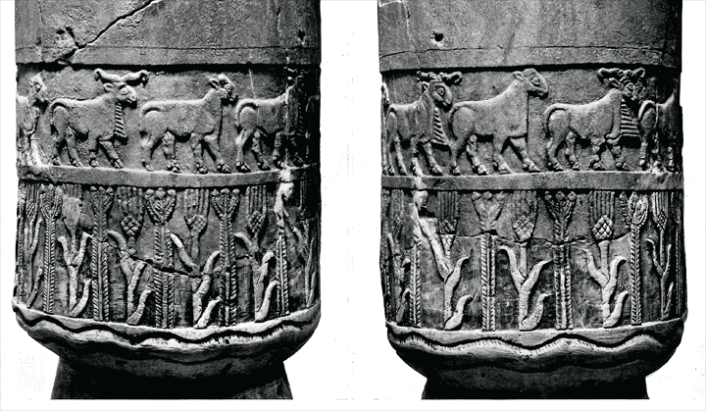
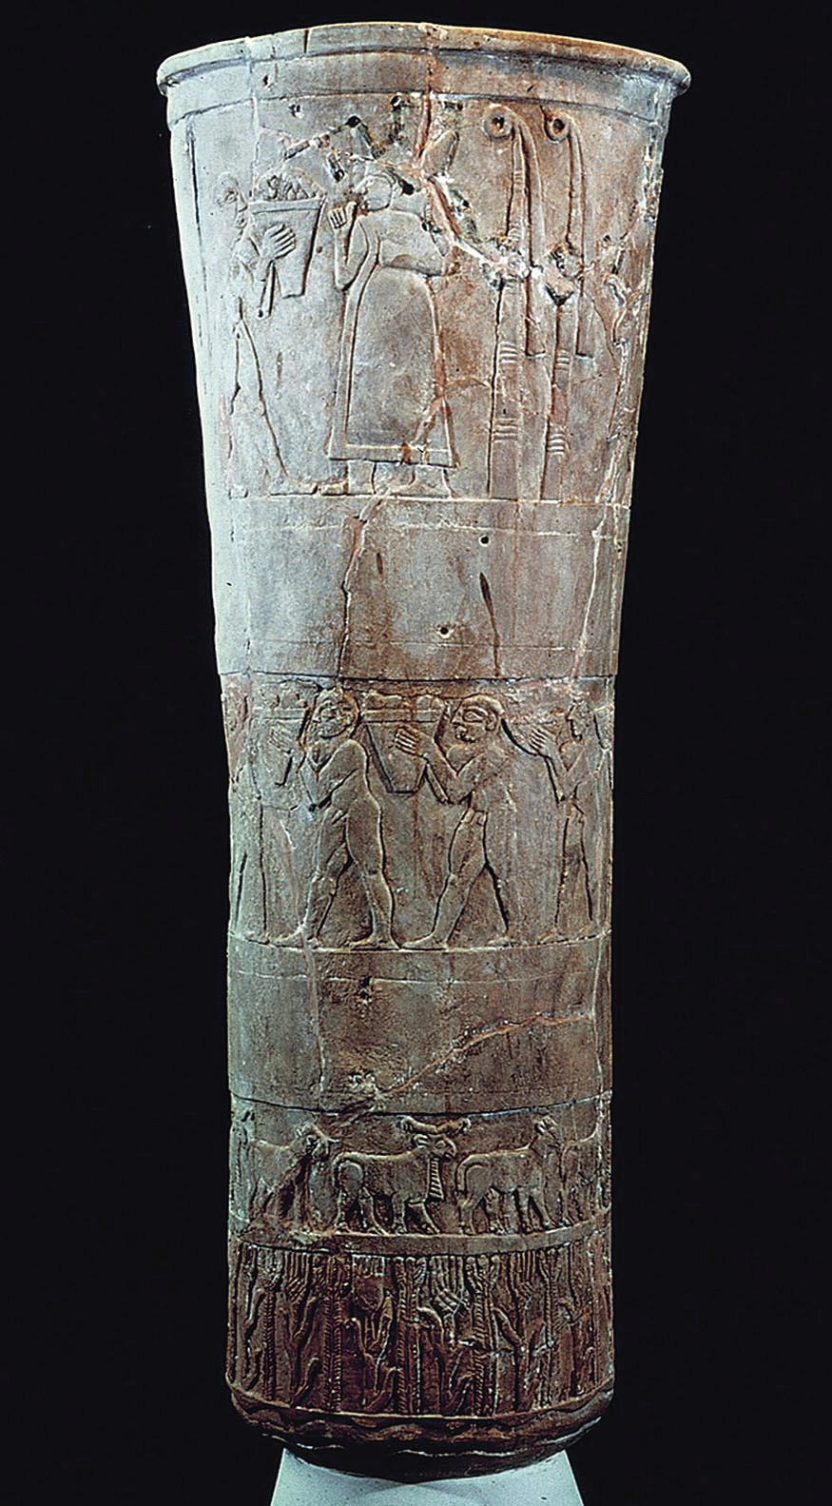
The Ethnobiology of the Warka Vase
Naomi F. Miller, Philip H. Jones, and Holly Pittman
University of Pennsylvania Museum
© October 22, 2015
Slightly revised version of a paper presented at the annual
meeting of Society for American Archaeology, Austin TX, April 26, 2014
Notes:
slide 1
This presentation is a summary of a much more detailed treatment, “Sign and Image: Representations of Plants on the Warka Vase of Early Mesopotamia,” by Naomi F. Miller, Philip Jones, and Holly Pittman. The longer manuscript will be posted online as soon as it is available. The original version was presented at the SAA in a symposium honoring Deborah M. Pearsall. © 2015, N.F. Miller, P.H. Jones, and H. Pittman

Slide 2
Warka vase
Warka Vase
(ca. 3200 BC, Uruk III)
(Strommenger 1964)
Notes:
slide 2
The Warka vase is one of the most important artifacts of ancient Mesopotamia. It is about a meter tall and is made of alabaster. It was probably part of a votive offering to Inana, who was the chief goddess of Mesopotamia, because it was found in her temple in the city of Uruk in a deposit dating to about 3200 BC.
The carving on the vase presents a complex iconographic composition. Epigraphers and art historians continue to debate whether it depicts aspects of the Inana cycle of stories that appear in literary texts from over a thousand years later. Scholars are divided over whether it concerns the renewal of fertility and abundance or the transfer of political power from the divine to human worlds. The Vase appears to depict a ritual, either real or mythic. Regardless, the imagery shows a narrative progression: alternating rams and ewes walk to the right at the base, men bearing baskets walk to the left in the middle, and in the upper register male figures facing right presents cloth and a basket to a female figure as the final scene. Other interpretations of the vase are consistent with this basic scheme. Bernbeck and Pollock have given it a political economy spin, pointing out that the basal water, plants and animals support the agricultural laboring class in the middle. And the laborers pay homage and tribute to the elite at the top. Winter points out that the imagery of nature's bounty can be seen as a celebration of fertility and abundance. Bahrani suggests that the vase may have been used in a ritual and also be a self-referential representation of that very ritual. Most scholars, including us, have assumed that the plant tier shows wheat or barley and some other plant. In this paper we will show that correct identification of the plants allows a more nuanced understanding of the composition.
Suter 2014
Bernbeck and Pollock 2006
Winter 2006
Bahrani 2002

Slide 3
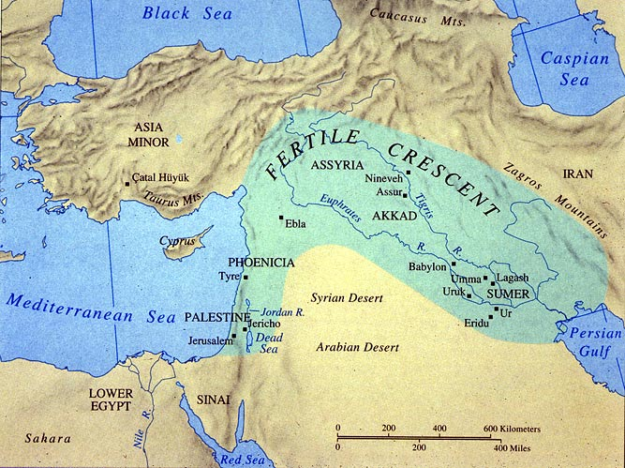
Mesopotamia
Uruk / Warka
Map source: http://notsincenineveh.wordpress.com/
Notes:
slide 3
[Here’s the location; Warka is just the Arabic name for ancient Uruk, also known to crossword puzzle solvers as the biblical Erech.]

Slide 4
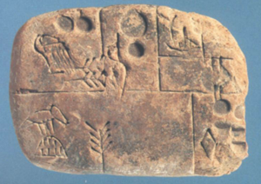
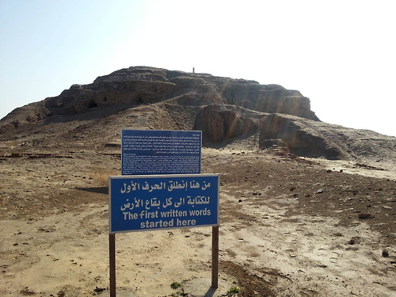
Birthplace of Writing
http://24.media.tumblr.com/d6f761b616dd2a09e6151230ce6950d6/tumblr_n1bno13r4f1ql5d2uo1_500.jpg
Notes:
slide 4
The first written signs impressed on clay tablets date to the second half of the fourth millennium BC in Uruk. The corpus of signs from the archaic texts has been published by Green and Nissen. Some of the signs can be translated, and some have only been assigned phonetic values.

Slide 5
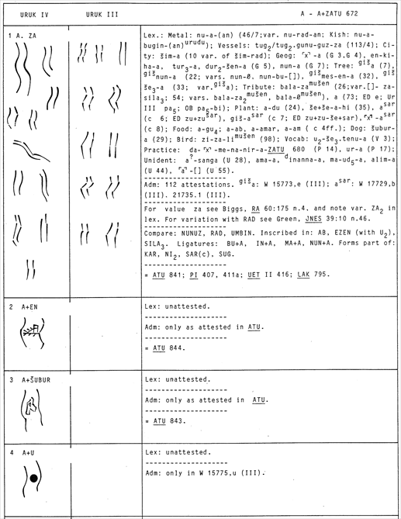
Example of a page of the Uruk sign list
Zeichenliste der archäischen Texte aus Uruk, by M.W. Green & H.J. Nissen
Notes:
slide 5
Some of the signs seem to be abstract, and some are representational, like sign number 1, which is the sign for water. A few years ago, Miller was looking for botanical imagery in the Uruk sign list, just to see if anything interesting would pop out.

Slide 6
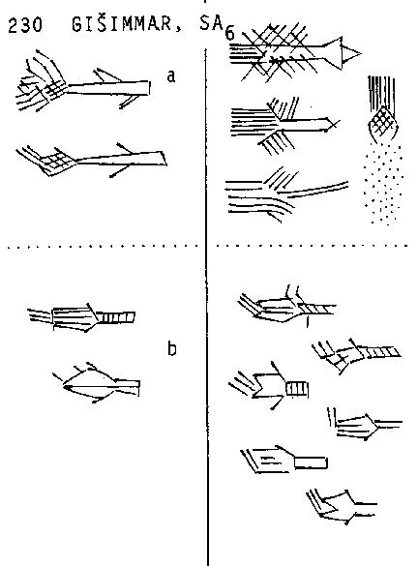
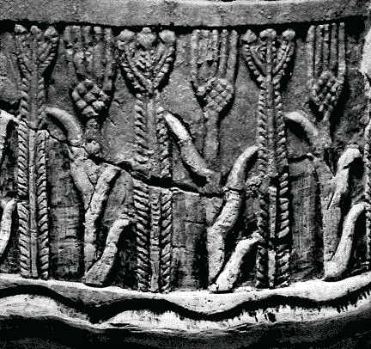

GIŠIMMAR
Notes:
slide 6
Imagine her surprise when she got to no. 230! The sign conventionally called GIŠIMMAR looked very similar to the so-called grain plant on the vase. GIŠIMMAR is the Sumerian word for the date palm. To help keep an open mind, we call that motif the 'cross-hatched plant'. And while we are at it, we call the other motif the trident plant.

Slide 7
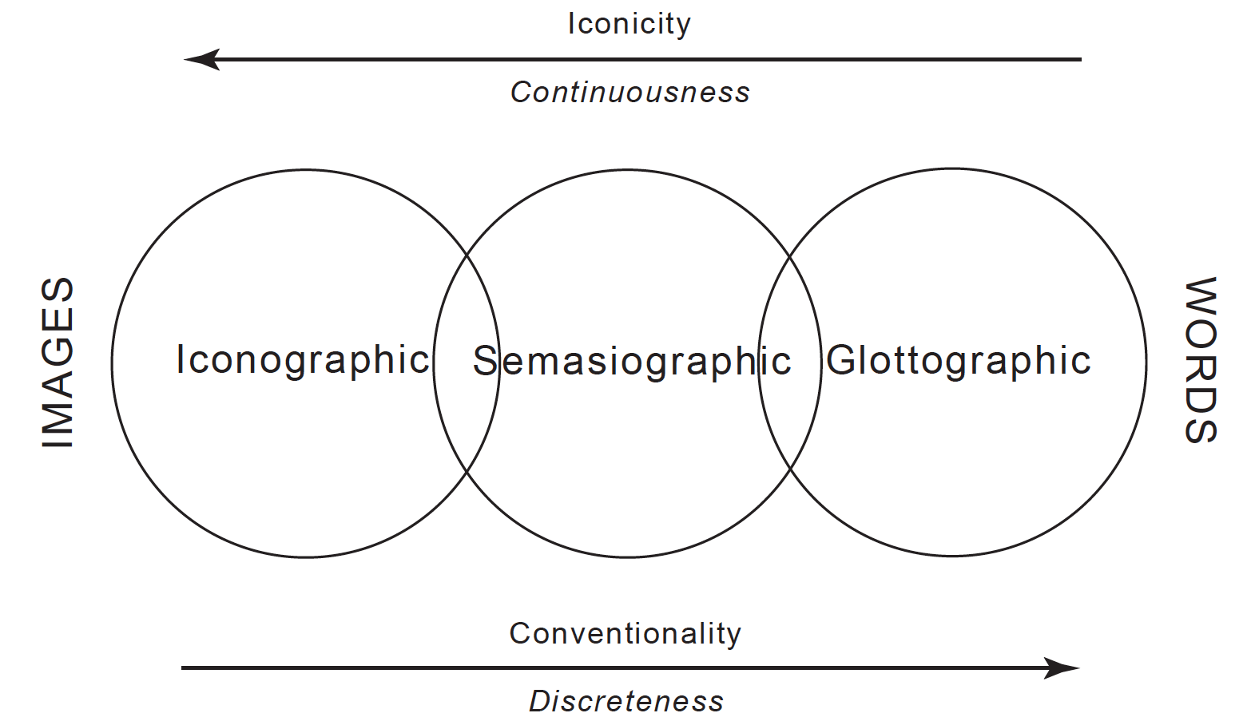
Uruk Period: The Beginning of Picture-Writing
“picture-writing”
Martin, S. 2006. On Pre-Columbian narrative: representation across the word-image divide
Notes:
slide 7
Visual representation of narrative can employ images, words, or something in between. Simon Martin's schematic diagram contrasts ideas expressed iconographically (with images), and those expressed glottographically (in words). In this diagram, the visual symbolic system of the Uruk period would lie just left of center; the Warka vase has a lot of iconographic imagery, but the conventions of written signs were developing at the same time.
Protoliterate Mesopotamia has a big advantage for iconographic study, because there are significant cultural continuities with the the cuneiform-text producing culture of later times. A big disadvantage is that those texts are separated from the Uruk period by more than a thousand years. That is a greater gap than the one separating the Classic Maya from the first ethnohistoric records and European observations. Jim Knight's book about "iconographic methods in New World prehistory" gives a useful perspective because it spells out an analytical approach that does not presume prior knowledge of language or narrative tradition. Knight points out that one of the first steps in an iconographic analysis is pulling together contemporary examples of the same motifs as they appear in the same or different media.
Martin 2006

Slide 8
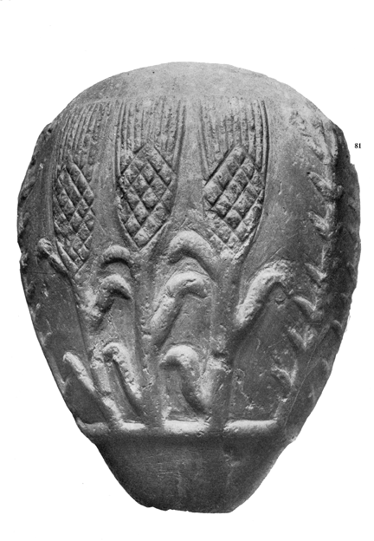
Warka Mace & Detail of Warka Vase
Notes:
slide 8
It turns out that there are a number of such plant images. For example, the Warka mace has alternating triplets of both the cross-hatch and trident plants.

Slide 9
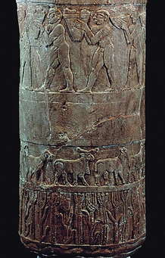
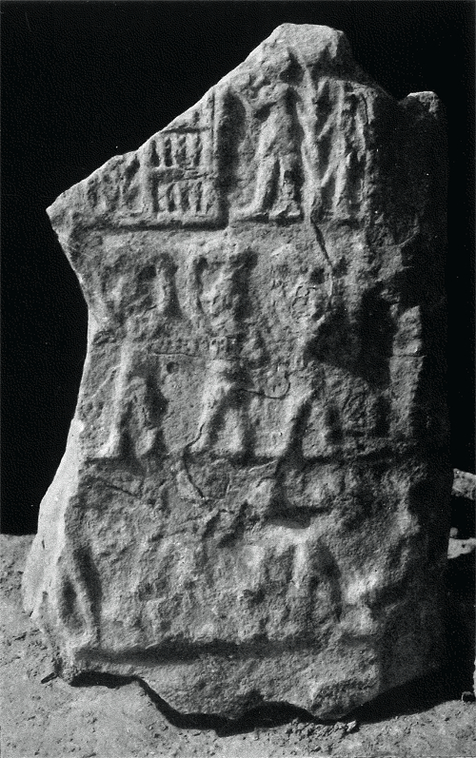
Warka Stele & Detail of Warka Vase
(Brandes 1965, Strommenger 1967)
Notes:
Slide 9
A little less clear is a plant form on the Warka stele, which also has poorly preserved but analogous representations of basket-bearers.

Slide 10
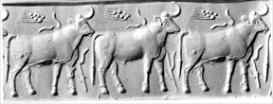
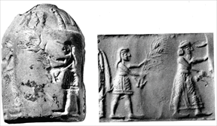
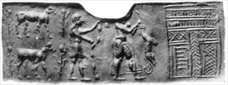

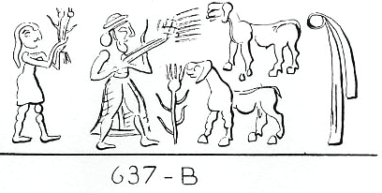
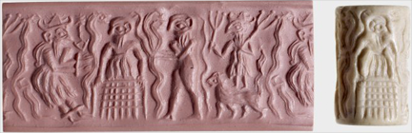
“Cross-hatch Plant” and “Trident Plant” in Glyptic
Notes:
slide 10
There is also an assortment of the motif carved on small cylinder seals. You can recognize the plant in the modern seal impressions from its cross-hatched head with vertical projections and a few linear leaves emerging from the stalk. Sometimes it is held as an offering and sometimes it emerges from the ground.

Slide 11
“Cross-hatch Plant” and “Trident Plant” in Glyptic
Notes:
slide 11
The trident plant identification in the glyptic is not as certain, but here's a potential example on the bottom, right.
The next step after assembling the comparanda is to consider what the referent might be. Knight says, "An obvious place to begin … is with the details of the natural environment." This is theoretically sound from the perspective of an ethnobiologist, because we know that the classification of the natural world is not arbitrary. It's based on shared human perceptual abilities that cut across time and space. That is why it is reasonable to conclude that the minimal and most literal interpretation of the the lowest register of the Warka vase is that it shows water and two types of plants.

Slide 12
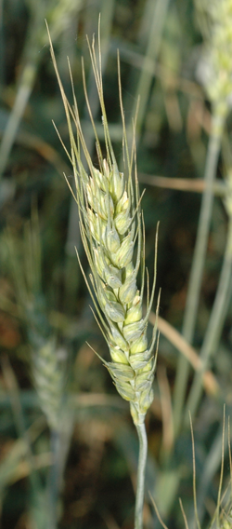
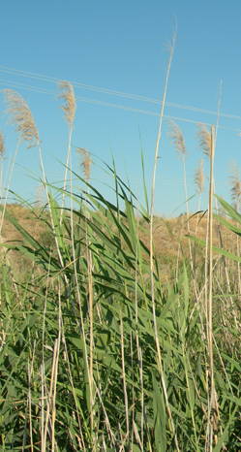
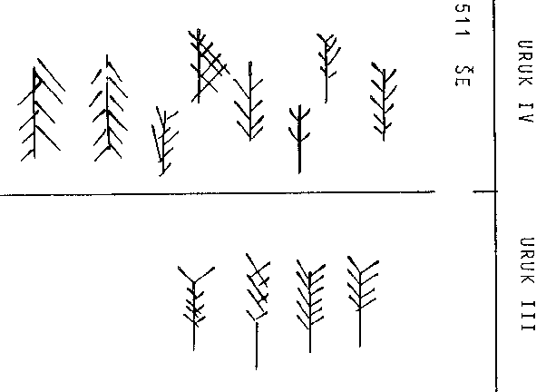
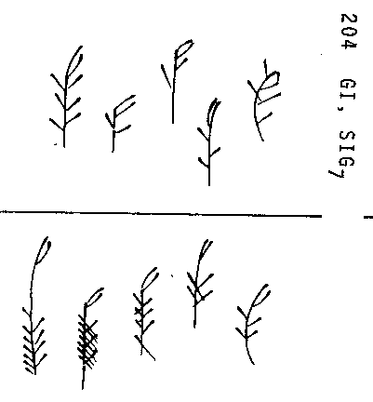
Grain or Reed ?
ŠE (grain)
GI (reed)
Notes:
slide 12
Since most of us have assumed that the cross-hatch plant is grain, and reeds are associated with water, we decided to compare the motif with the archaic signs for grain and reed. Miller had never been totally persuaded that the cross-hatched motif on the Warka Vase represented grain, because grain grows 2-ranked up the stalk. Here, you can see that the ŠE sign evokes an awned head of grain, like this head of wheat. The GI sign evokes a reed, with leaves jutting at an angle from the stem and a curving inflorescence.

Slide 13
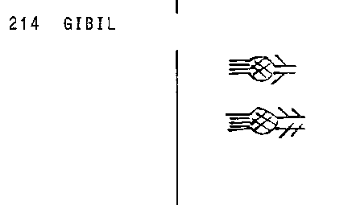
Date Palm Offshoot ?
GIŠIMMAR
GIBIL
GIBIL
Pennsylvania Sumerian Dictionary: gibil = sprout, offshoot
Notes:
slide 13
We were pretty happy that the cross-hatch plant matched the sign for the date palm. By the time we discovered that Mark Brandes had made the same observation in 1965, Miller had already noticed sign no. 214, not available to Brandes. The archaic GIBIL sign seems an even better fit for the cross-hatch plant than GIŠIMMAR. The epigraphers are willing to assign a value to it, but they are not confident enough to say what it means. Nevertheless, the later cuneiform sign for GIBIL has been assigned a meaning. The Pennsylvania Sumerian Dictionary gives a definition of sprout or offshoot. Rather than assume the cross-hatch plant specifically represents a date palm offshoot, we use the cuneiform definition of gibil as a hypothesis to be tested with our ethnobotanical understanding of palm cultivation. [Note: In the finished article, the sumerologist on our team, Philip H. Jones, will be presenting a much more detailed discussion of the later meaning of the word ‘gibil’ and its connection to the sign.]

Slide 14
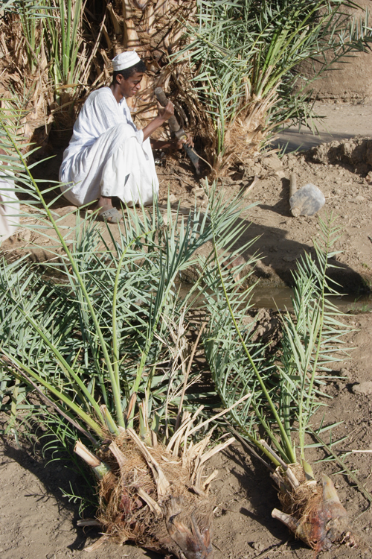
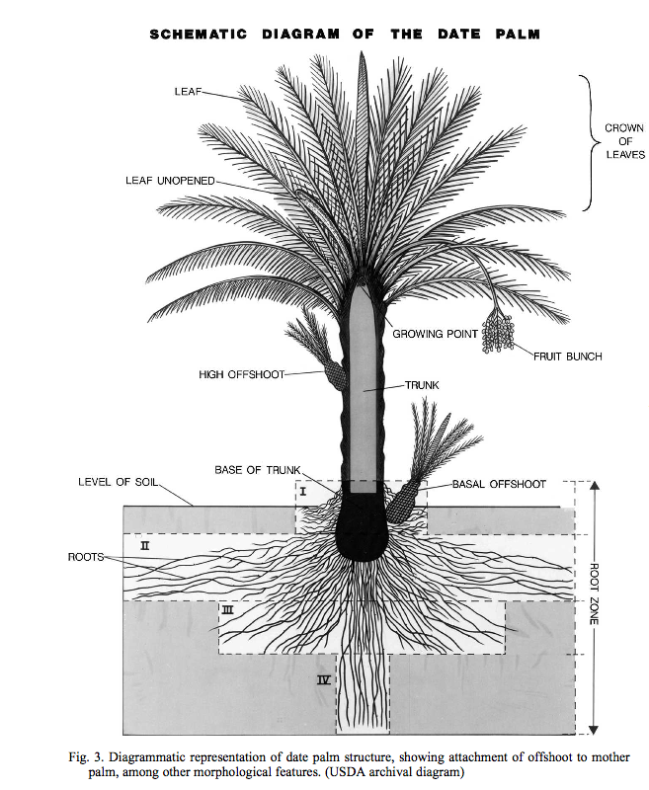
Date Palm
Propagation by Offshoot
http://upload.wikimedia.org/wikipedia/commons/4/41/Shatla.JPG
USDA
Notes:
slide 14
Date palms are dioecious, which means they have male and female flowers. In the wild, half of the trees are male and half are female. In an orchard, you need one male tree to pollinate about 50 female trees. It's the female trees that produce the fruit. If you grow dates from seed, their offspring will have unpredictable traits. Therefore, date varieties are maintained by clonal propagation of offshoots. It also may be significant for us that there are some male plants whose pollen is particularly valuable, and they are clonally propagated, too.

Slide 15
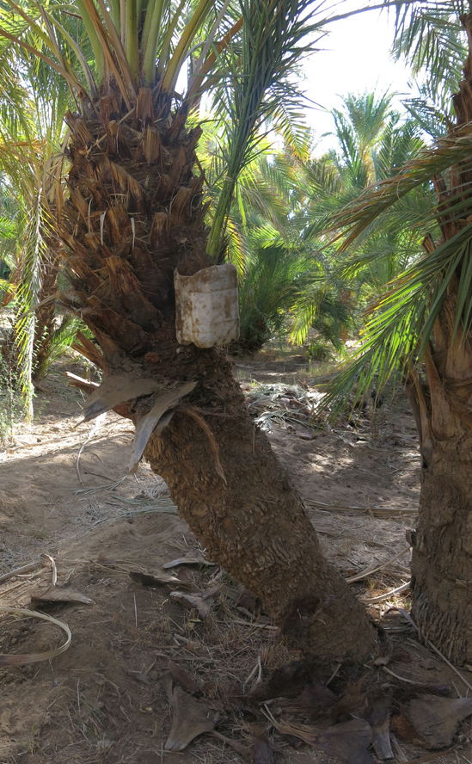
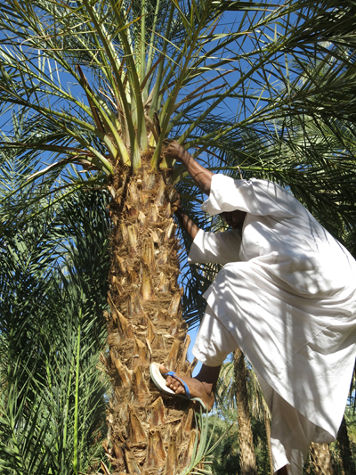
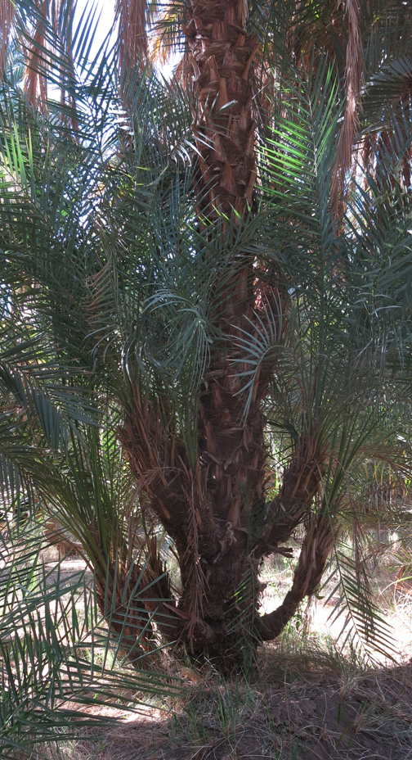
Date Palm
Offshoots
Notes:
slide 14a
In February, 2015, Miller had the opportunity to visit a date palm grove in Sudan that is cultivated without mechanization. Notice the cross-hatched appearance left at the bases of the leaves. A date farmer demonstrated that the palm fronds are cut off to make it easier to climb the tree.

Slide 16
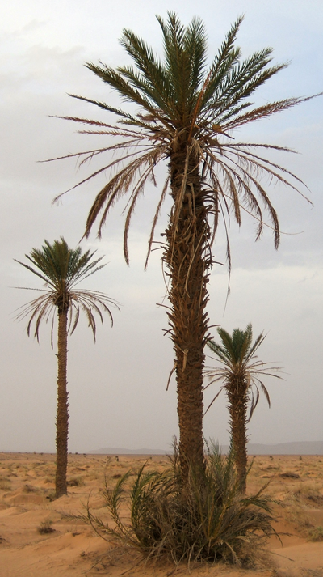
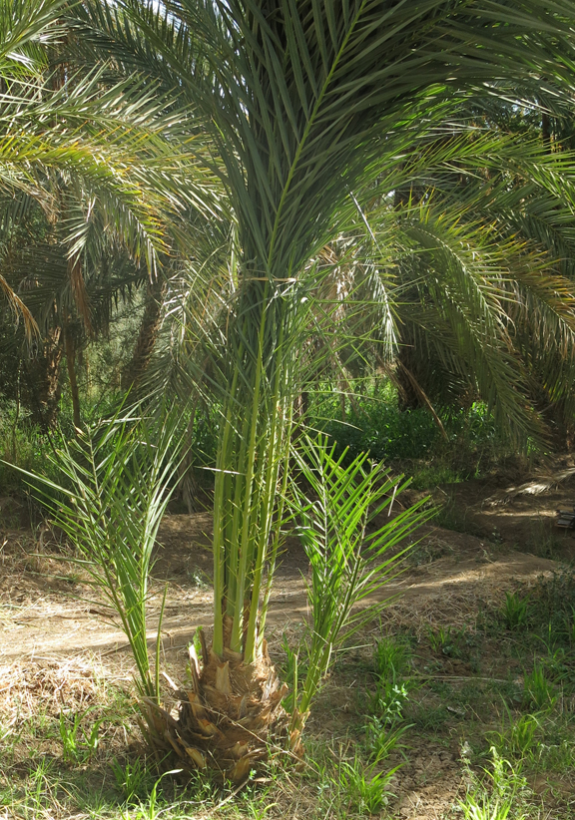
Palm or Palm Offshoot?
GIŠIMMAR
GIBIL
http://upload.wikimedia.org/wikipedia/commons/c/c0/Phoenix_dactylifera2.jpg
Notes:
slide 16
Date palms are woody monocots, like bamboo. They do not form annual rings, but as they grow, the palm fronds emerge in a spiral up the trunk. As the leaves fall off or are trimmed under cultivation, the leaf bases give the trunk a characterstic cross-hatched appearance, which is a very salient for its identification.
Ethnographic analogy certainly supports the identification of the cross-hatch plant as a date palm offshoot.

Slide 17
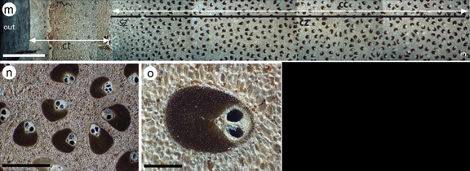
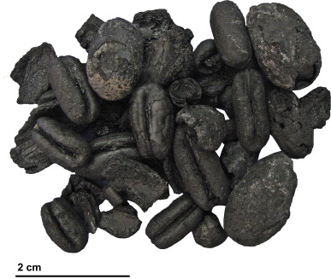
Archaeobotanical Evidence for Dates
Date wood cross-section
& microstructure
Carbonized whole fruits and seeds of date palm
Date pits & fruits
* Images show modern wood (Thomas 2013) & charred Iron Age fruits and pits (Tengberg 2012)
Notes:
slide 17
Mesopotamia has not produced a lot of archaeobotanical evidence, but both wood and date pits have been reported for pre-Uruk sites. So it is safe to say that the date palm was known in Mesopotamia, where it would have grown in irrigated groves and gardens.
We know that the date continued to be important economically, as it is to this day, but the cross-hatch plant motif drops out of Mesopotamian iconography by the mid-3rd millennium BC. In order to connect the iconography of the Warka vase to later narrative traditions, we must demonstrate continuity in the symbolic importance of the date palm, too.
'Oueli (wood; Neef1991) and Eridu (stones; Gillet 1976)

Slide 18
Mesopotamia
Uruk/Warka
Ur
Map source: http://notsincenineveh.wordpress.com/
Notes:
slide 18
And we can do that. It shows up in the Royal tombs of Ur. [There's Ur just to the southeast of Uruk].

Slide 19
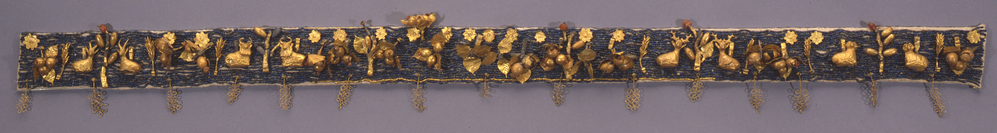
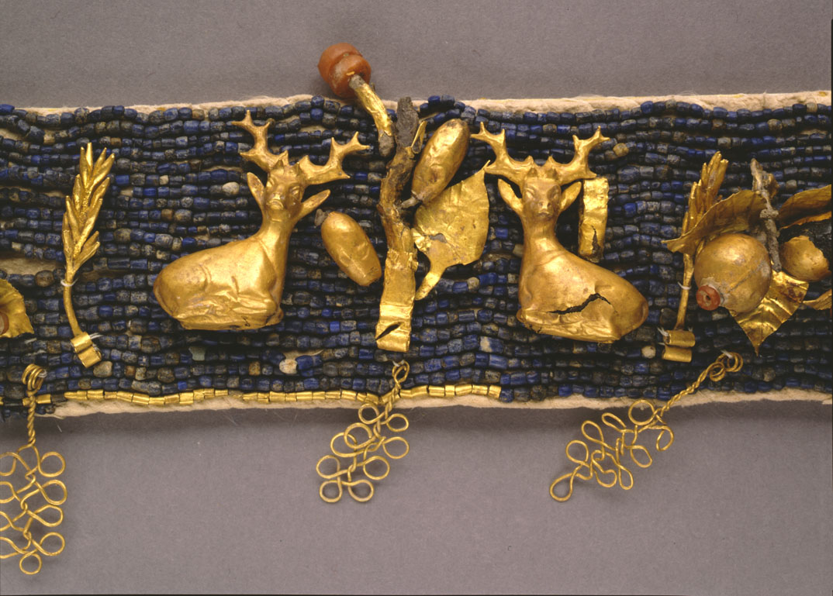
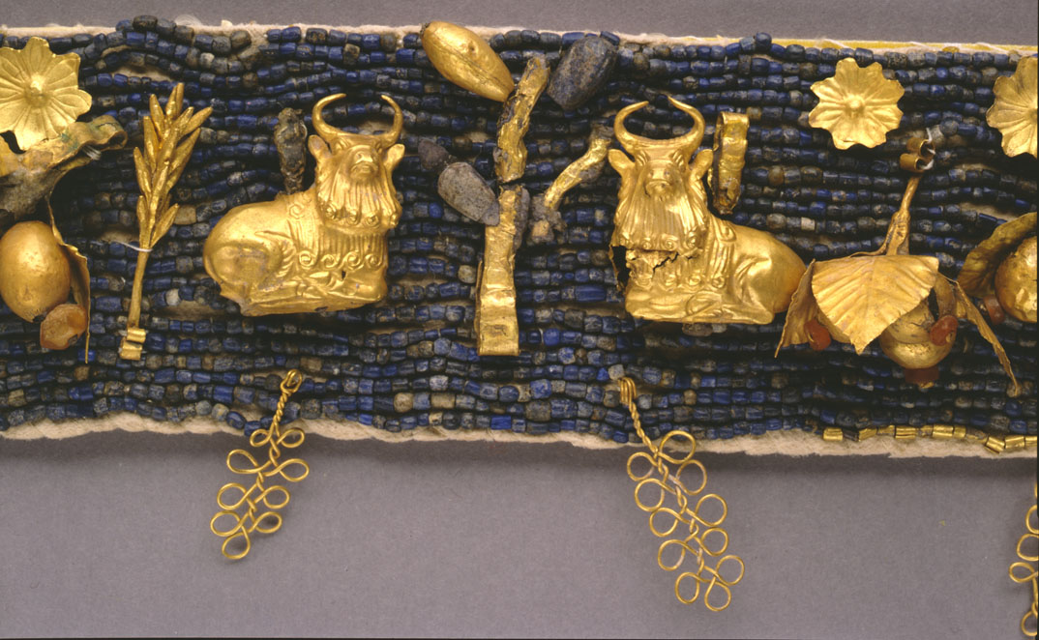
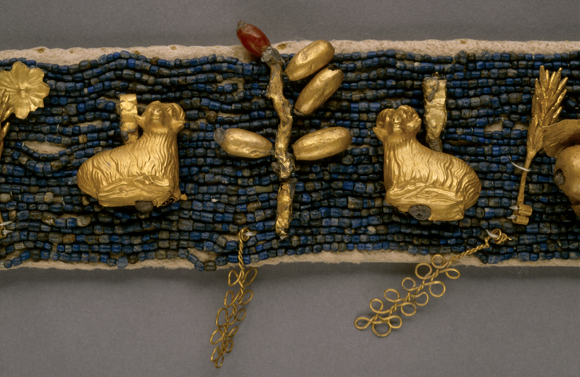
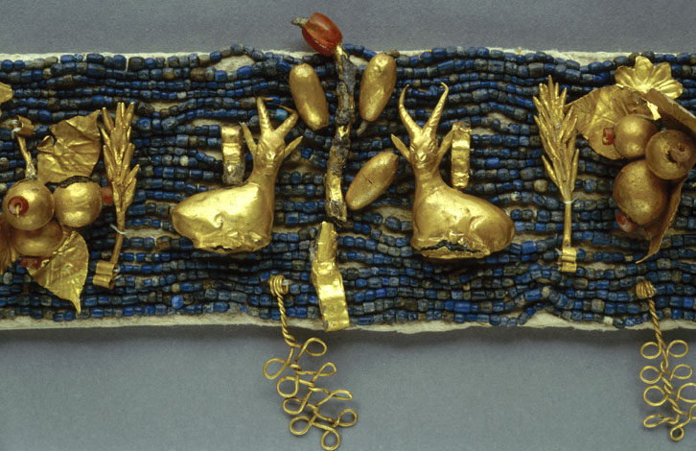
The “Diadem” from Ur (ca. 2500 BC)
Most Ur images from Penn Museum or Penn Museum website, http://www.penn.museum/
Notes:
slide 19
The so-called diadem of Ur dates to about 2500 BC, and has a bunch of plant and animal forms.

Slide 20
Who is to say which way is up?
Miller, N.F. 2000. Plant Forms in Jewelry from the Royal Cemetery at Ur
Notes:
slide 20
For many years, the plant pendants were mounted upside down in the Penn Museum display case.

Slide 21
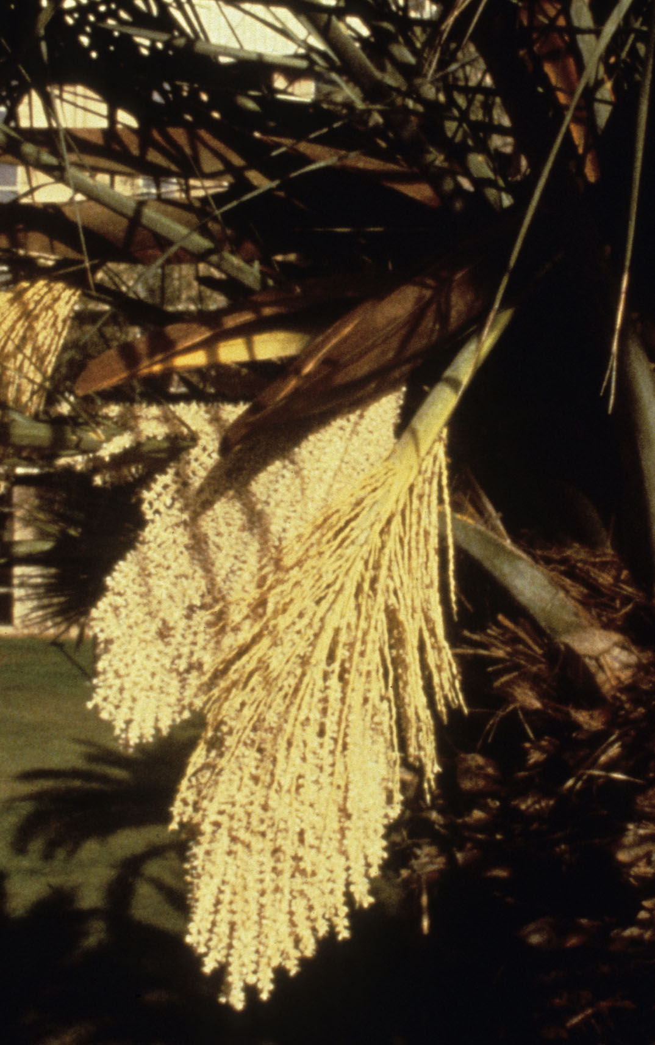
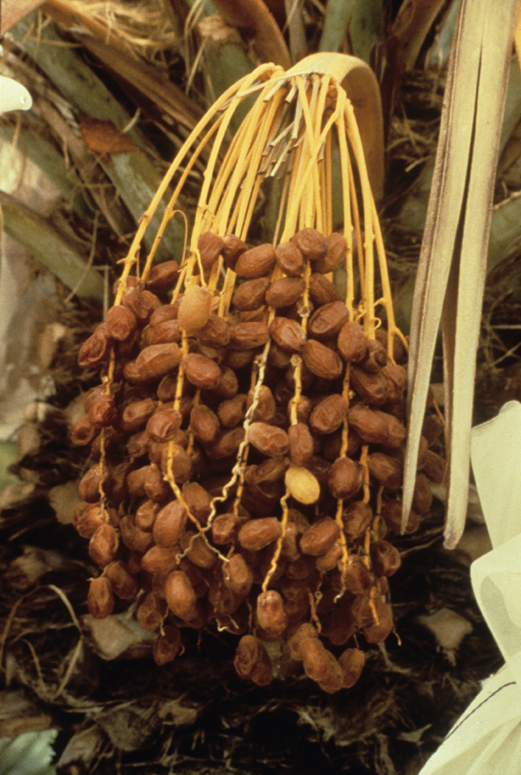
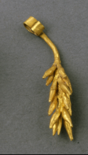
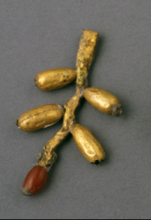
Art Imitates Life
Univ. of Arizona
♂
♀
Univ. of Arizona
Univ. of Arizona
Notes:
slide 21
Now that we know the items come from several different pieces of jewelry, it's easy to see that the pendants represent the male and female inflorescences of the date palm.

Slide 22
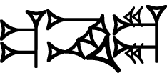
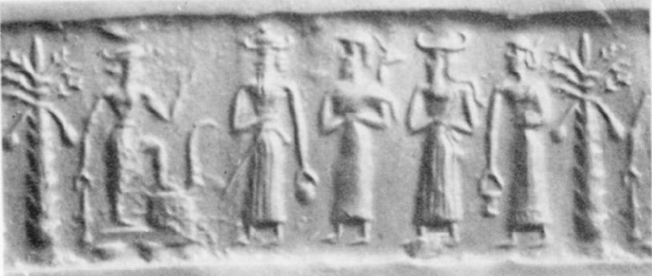
Late 3rd millennium: Words & Images
sprout, offshoot (gibil)
Martin 2006; Pennsylvania Sumerian Dictionary; Moorey & Gurney 1978 (Seal no. 24)
Notes:
slide 22
By 2000 BC, the two systems of narrative representation had fully differentiated. Images come to illustrate or reference stories that had previously been transmitted orally. Those stories came to be recorded in words written in cuneiform. The Inana stories are among the most fundamental to Mesopotamian civilization. They deal with life and death, and they are linked with the idea of fertility in both production and reproduction.

Slide 23
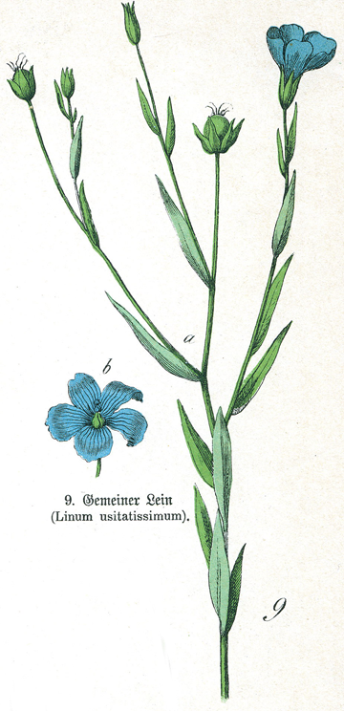
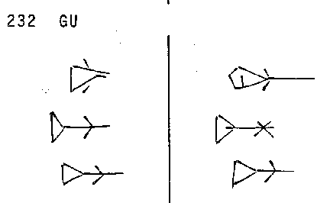
Flax
(original suggestion of Harriet Crawford, Irene Winter)
GU
gu = unretted flax stalks (PSD)
http://upload.wikimedia.org/wikipedia/commons/3/34/Linum_usitatissimum.jpg
Notes:
slide 23
That brings us to the trident plant. The leaves overlapping along the stem, fruits at the ends of the branches, and the triangular silhouette fit with an identification of flax. You can also see some analogy with the archaic sign, which is an inverted triangle on a stalk with leaves. Harriet Crawford and Irene Winter first proposed the identification of flax in the Warka Vase imagery, partly because flax is associated with Inana in the stories of the second-millennium BC.

Slide 24
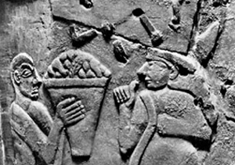
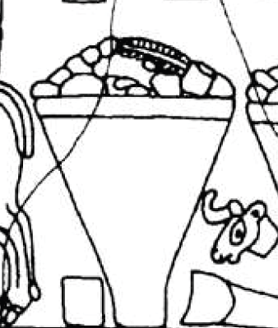
Narratives:
Gendered
&
Political
Notes:
slide 24
Our interpretation of the plants supports both a gendered and political narrative for the vase. With regard to gender, in Mesopotamia, the heavy agricultural work of palm cultivation is more of a male occupation, and weaving a female one, so gender roles are arguably implicit in the presentation of the presentation of the plants. The sheep do not depict a normal herd, which, for management purposes, would be primarily female or, for wool herds, female and castrate. Thus, the file of animals, unambiguously alternating male and female, even more securely suggests gendered subject matter. Symbolically uniting the top and bottom of the composition, we propose that the gifts presented to the female figure include linen cloth (made from flax fiber) and ripe date.
With regard to the political aspect, both flax and dates require more water than grain. Therefore, the flowing water shown at the base of the Vase now suggests plants growing in a garden, rather than a field. In some of the earliest narratives and imagery of Mesopotamia (admittedly post-dating the vase by centuries), ”the ruler is shown as gardener, shepherd or hunter of wild beasts.” In our interpretation, the lowest register now refers to the ruler as metaphorical gardener and shepherd. A specifically political interpretation of the lowest register supports Hockmann’s proposal that several city emblems are shown in the upper register.
Novák 2002

Slide 25

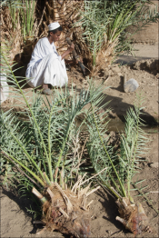


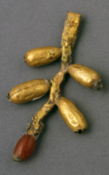

Ethnobiology of the
Warka Vase
Botany &
ethnobotany
Archaeobotany
(seeds and wood)
c. 2000 BC
literary texts
c. 2500 BC
imagery
c. 3200 BC
imagery & pictographs
Notes:
slide 25
An ethnobiological approach encourages us to pull together different kinds of data.
At the most botanically literal, we see date palms and flax plants on the vase.
Ecologically, we see two plants that must be irrigated growing in association with flowing water, which in turn suggests a garden habitat. The later cuneiform texts are consistent with that idea.
Ethnobiologically, the alternating rams and ewes above the row of plants do not represent an actual domestic flock, which would have many more females than males. This understanding opens the door to gendered interpretations of the iconography.
Along the same lines, an economic interpretation will note that the heavy labor involved in date palm cultivation is most likely to be men's work, and the later cuneiform texts confirm that agriculture was men's work and textile production was women's work.
On somewhat shakier symbolic grounds, we argue that even if the date offshoot motif does not specifically reference a virile young male plant, the alternation of palm and flax may well symbolize the same complementarity of male and female as is shown in the animal tier.
Finally, we can bring in theSumerian texts that are later, but in a direct cultural line with the Warka vase to support a political meaning for the lowest register.
This is not the place to explicate the Warka vase in detail, and the correct identification of the plants does not directly address the complex Inana narratives. It does, however, provide a very satisfying complement to interpretations based on enduring Mesopotamian tropes of fertility and abundance. Furthermore, combining the gender and politics, we argue that Warka vase represents some ritual of (political) alliance, either mythical or real.

Slide 26
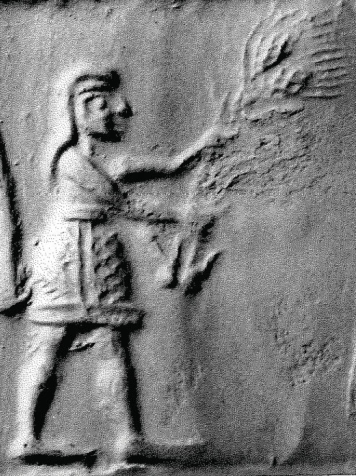
Thank You!
This paper is based on a collaborative work in progress with the working title:
Sign and Image: Representations of Plants on the Warka Vase of Early Mesopotamia
Naomi F. Miller, Holly Pittman, and Philip Jones
Notes:
slide 26
References
Bahrani, Z. 2002. Performativity and the image: Narrative, representation and the Uruk vase. In Leaving No Stones Unturned: Essays on the Ancient Near East and Egypt in Honor of Donald P. Hansen, ed. E. Ehrenberg, pp. 15–22. Eisenbrauns, Winona Lake, Indiana.
Bernbeck, R. and Susan P. 2002. Reflections on the historiography of 4th millennium Mesopotamia. In Material Culture and Mental Spheres, eds. A. Hausleiter, S. Kerner, and B. Müller-Neufof, pp. 171–204. Ugarit Verlag, Münster.
Brandes, M. 1965. Bruchstück einer archaischen Stele aus Uruk-Warka. Archäologischer Anzeiger 1965: 590–620.
Crawford, H. 1985. A note on the vegetation on the Uruk Vase. Bulletin on Sumerian Agriculture 2: 73–76.
Frankfort, H. 1996 (1954). The Art and Architecture of the Ancient Near East, 5th ed. Yale University Press, New Haven.
Gillet, J. B. 1976. Botanical Samples. In Eridu, eds. F. Safar et al., pp. 317-318. Ministry of Culture and Information. Baghdad.
Green, M.W. and H.J. Nissen. 1987. Zeichenliste der archäischen Texte aus Uruk. Archäische Texte aus Uruk, Band 2. Ausgrabungen der deutschen Forschungsgemeinshaft in Uruk-Warka 11. Gebr. Mann Verlag, Berlin.
Jacobsen, T. 1976. The Treasures of Darkness. Yale University Press, New Haven.
Knight, Vernon James, Jr. 2013. Iconographic Method in New World Prehistory. Cambridge University Press, Cambridge.
Martin, Simon. 2006. On Pre-Columbian narrative: representation across the word-image divide. In A Pre-Columbian World, eds. J. Quilter and M. Miller, pp. 55–105. Dumbarton Oaks Research Library and Collection, Washington D.C.
Miller, Naomi F. 2000. Plant Forms in Jewelry from the Royal Cemetery at Ur. Iraq 62: 149–155.
Moorey, P.R.S. and O. R. Gurney. 1978. Ancient near Eastern Cylinder Seals Acquired by the Ashmolean Museum, Oxford 1963–. Iraq 40: 41–60. Akkadian style, Seal no. 24
Novák, Mirko. 2002. The Artificial Paradise: Programme and Ideology of Royal Gardens. In Sex and Gender in Ancient Near East, eds. S. Parpola and R.M. Whiting, pp. 443–460. Helsinki.
Neef, Reinder. 1991. Plant Remains from Archaeological Sites in Lowland Iraq: Tell el 'Oueli. In 'Oueili, Travaux de 1985, J.-L. Huot, pp. 321-329. Editions Recherche sur les Civilisations, Paris.
Strommenger, E. 1964. 5000 Years of the Art of Mesopotamia, tr. C. Haglund. Harry N. Abrams, New York.
Suter, C. 2014. Human, divine or both? The Uruk Vase and the problem of ambiguity. In Critical Approaches to Ancient Near Eastern Art, eds. M. Feldman and B. Brown, pp. 545–568. Walter de Gruyter, Berlin.
Tengberg, M. 2012. Beginnings and early history of date palm garden cultivation in the Middle East. Journal of Arid Environments 86: 139–147.
Thomas, R. 2013. Anatomy of the endemic palms of the Near and Middle East: archaeobotanical perspectives. Revue d’Éthnoécologie 4. http://ethnoecologie.revues.org/1366 Winter, I. 2006. Representing abundance: The visual dimension of the agrarian state. In Settlement and Society: Essays Dedicated to Robert McCormick Adams, ed. E. Stone, pp. 117–138. Cotsen Institute of Archaeology, Los Angeles.
Winter, I. 2006. Representing abundance: The visual dimension of the agrarian state. In Settlement and Society: Essays Dedicated to Robert McCormick Adams, ed. E. Stone, pp. 117–138. Cotsen Institute of Archaeology, Los Angeles.
ABSTRACT: Rich ethnobiological study of antiquity is usually constrained by the limitations of the archaeological remains of plants and animals. Sometimes, ongoing tradition, images and texts add a symbolic dimension. Such a study has been done of the Warka Vase, an iconic artifact of Mesopotamia. The lowest of three registers appears to represent the basis of Mesopotamian life: water, plants, and animals. Identification of the water and animals is relatively straightforward. In the absence of serious botanical study, the plants depicted are usually thought to be grain and flax. Analysis of the plant imagery in concert with that of archaic signs, botanical charactistics, and our understanding of Mesopotamian agriculture and tradition shows that the 'grain' is date palm and confirms the other plant as flax.

